Slide 1
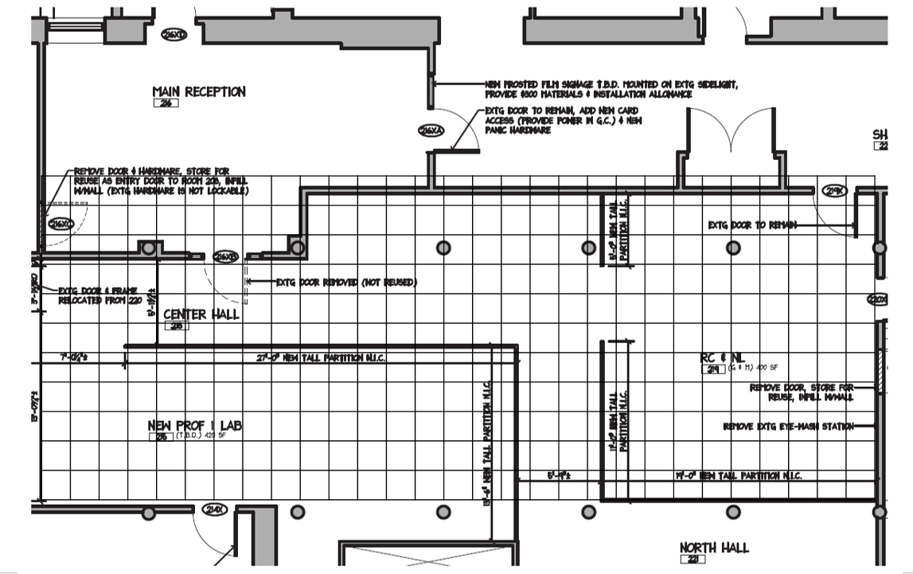

North
$$0°$$

